Slide 1
Lesson objective
Title: Perimeter and area
Aim:
TBAT calculate the perimeter and area of a composite shape.
Plan:
Unit conversions
Review perimeter and area
Area and Perimeter of composite shapes

Slide 2

45cm = ______mm
20 000m = ______km
2m = ______mm

Slide 3
Convert these to metres
Apply
300cm
= 3m
0.6km
= 600m
0.073km
= 73m
700cm
= 7m
0.33km
= 330m
654cm
= 6.54m
800cm
= 8m
153cm
= 1.53m
3250mm
= 3.25m
250cm
= 2.5m
1000mm
= 1m
2.04km
= 2040m
180cm
= 1.8m
2200mm
= 2.2m
50300mm
= 50.3m

Slide 4
Example
5cm
3cm
The rectangle has a perimeter of:
5
+
3
+
5
+
3
=
16cm
The rectangle has a area of:
5
+
5
+
5
=
15cm²
5
×
3
=
15cm²
Take note of the units!

Slide 5
Perimeter
Perimeter
The boundary that forms a 2D shape.
It is calculated by adding ALL the sides.
Area
The space inside a shape.
Each shape has a specific formula used to calculate.

Slide 6
Perimeter
Perimeter
The boundary that forms a 2D shape.
It is calculated by adding ALL the sides.
Area
The space inside a shape.
Each shape has a specific formula used to calculate.

Slide 7
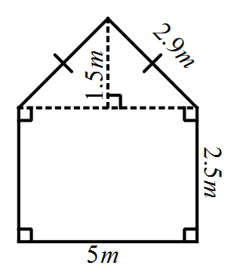
4. Calculate the perimeter of this composite shape.

Slide 8
3. Calculate the perimeter of this sector.
10cm

Slide 9
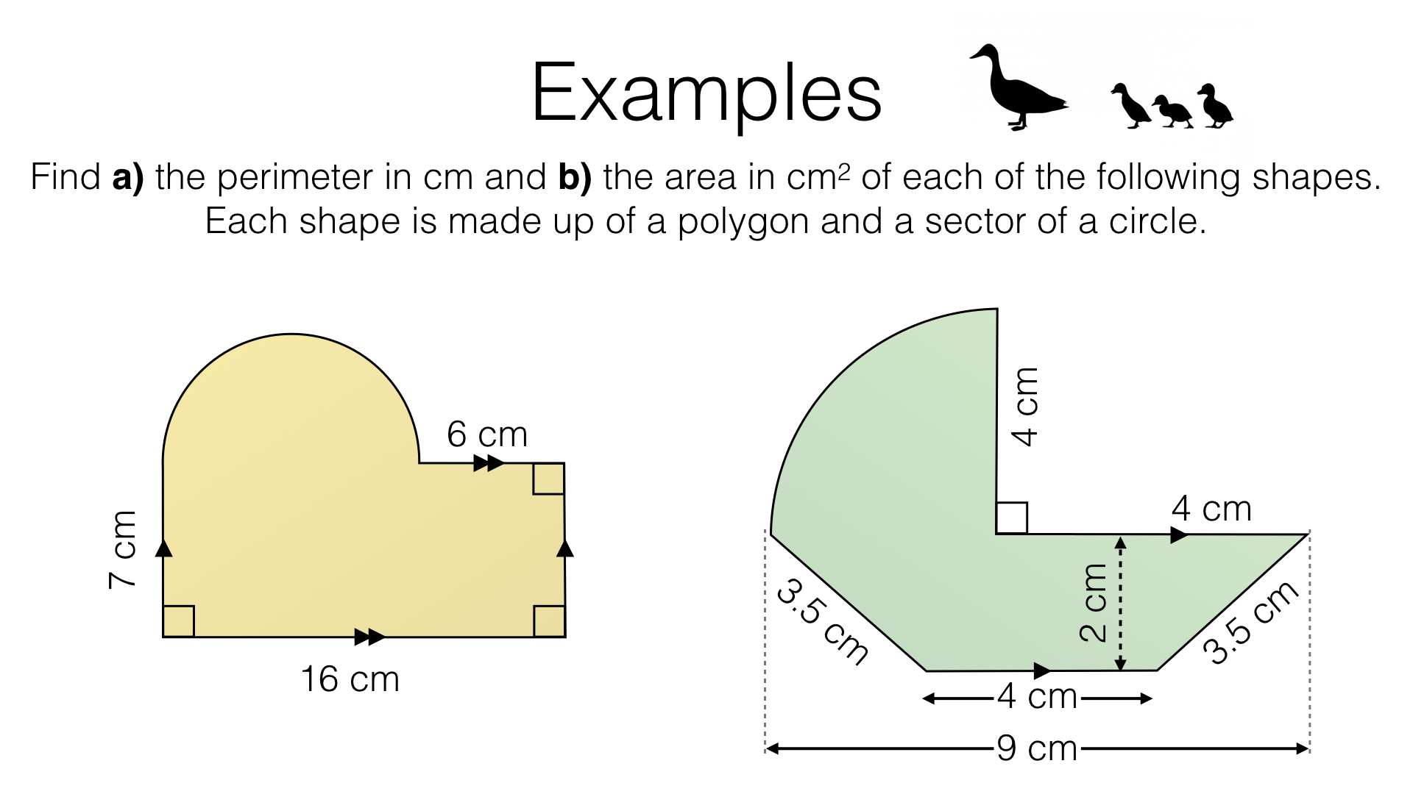

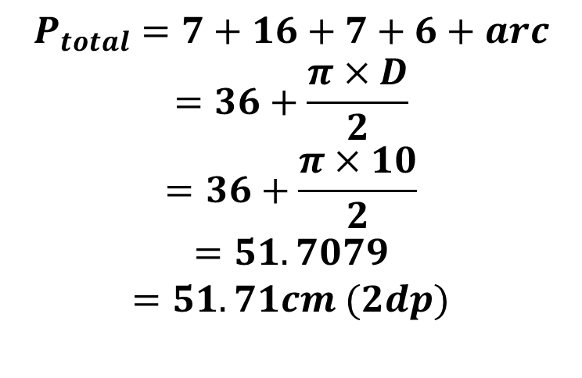






Aim: TBAT calculate the perimeter and area of a composite shape
1
10cm
$$P_{total}=7+16+7+6+arc$$
$$=36+\frac{π×D}{2}$$
$$=36+\frac{π×10}{2}$$
$$=51.7079$$
$$=51.71cm (2dp)$$
2
$$A_{total}=A_{1}+A_{2}$$
$$=0.5×π×r^{2}$$
$$+W×L$$
$$=0.5×π×5^{2}$$
$$+16×7$$
$$=151.2699$$
$$=151.27{cm}^{2} (2dp)$$

Slide 10
Aim: TBAT calculate the perimeter and area of a composite shape
1
2

Slide 11
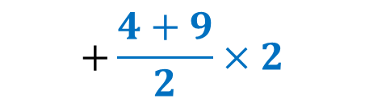
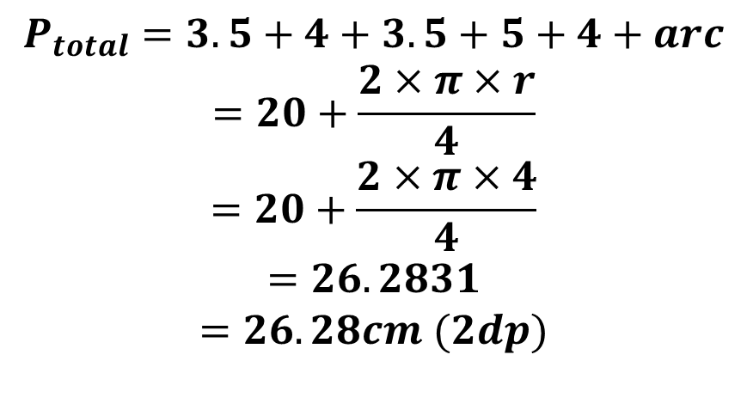
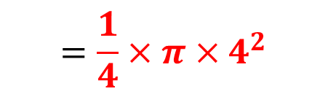

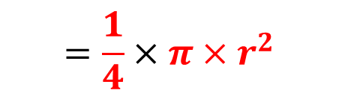



Aim: TBAT calculate the perimeter and area of a composite shape
1
4cm
5cm
$$P_{total}=3.5+4+3.5+5+4+arc$$
$$=20+\frac{2×π×r}{4}$$
$$=20+\frac{2×π×4}{4}$$
$$=26.2831$$
$$=26.28cm (2dp)$$
2
$$A_{total}=A_{1}+A_{2}$$
$$=\frac{1}{4}×π×r^{2}$$
$$+\frac{a+b}{2}×h$$
$$=\frac{1}{4}×π×4^{2}$$
$$+\frac{4+9}{2}×2$$
$$=25.5663$$
$$=25.57{cm}^{2} (2dp)$$

Slide 12
Aim: TBAT calculate the perimeter and area of a composite shape
1
2

Slide 13
Individual practice
Continue activity sheet
Area – compound shapes (Lesson 6-7 PDF 2)

